Slide 1
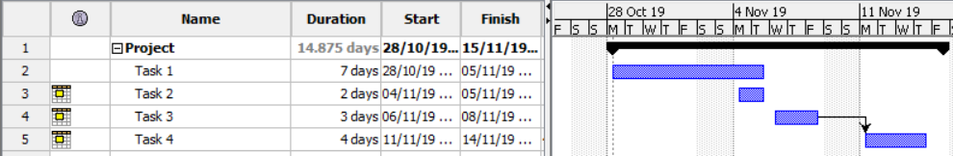
Gantt Charts
A gantt charts is a timeline that is used as a project management tool
Reasons to use gantt charts:
Time efficient
Communication
Memorable
Notes:
Steps:
1.Explanation of gantt chart
2.Explain the image and finish of saying that this is a simple overview of a gantt chart
3.Mention and expand on the reasons to use gantt charts

Slide 2
Timescale
Estimated time for our project to be finished:
20/12/19
Training:
Dedicate one day to training
Simple explanation of how to use the system
Notes:
Steps:
1. Explanation of when we are to expect the project to finish (20th December 2019)
2.A simple explanation of our project
3. Mention that one day is dedicated to training (train one employee at a time) / Include what the training will consist

Slide 3
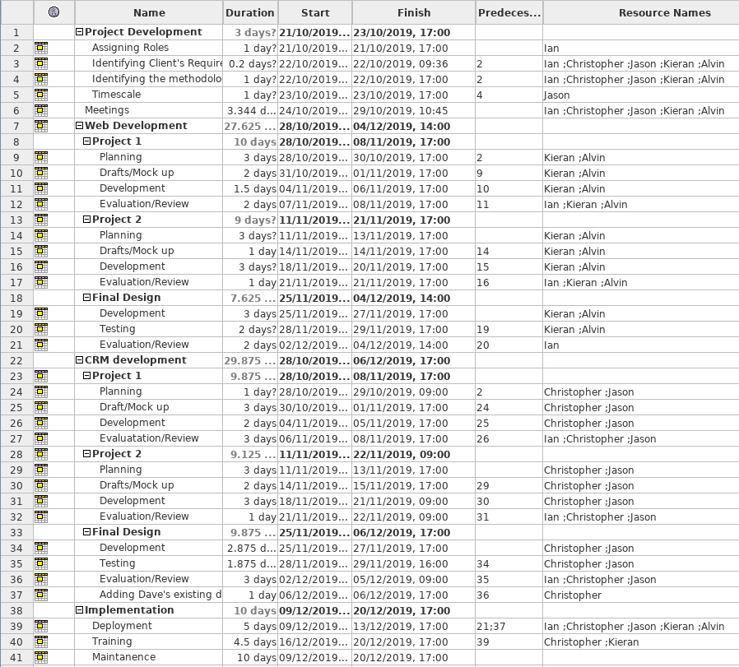
Gantt Charts
Notes:
Explain the steps we taken to build the project
Steps:
1. A simple brief on the image

Slide 4
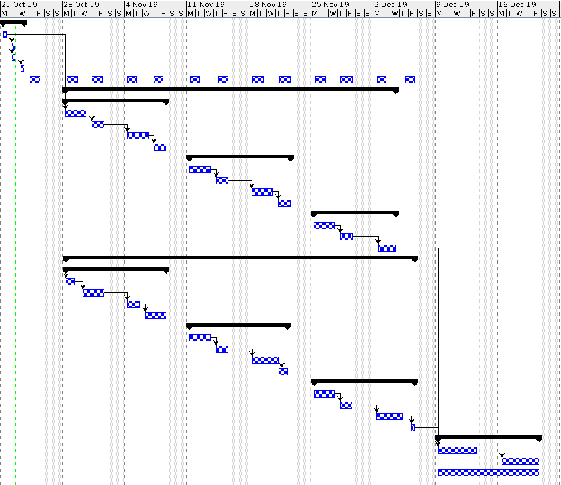
Notes:
Simple Brief of each summary task (mention their time)
Steps:
1.Mention the duration of each summary task, explain each of the summary task.
2.Mention the recurring task
3.Simple brief of the project

